Slide 1
EXPLORING THE BENEFITS OF MACHINE LEARNING FOR ENHANCING CUSTOMER SUPPORT IN BUSINESSES Oludayo Abiodun Adeoye
Study center: Tallinn Curriculum: Software Development and Entrepreneurship Supervisor: Inna Shvartsman

Slide 2
Research problem
The growing customer service demands for efficiency, personalization, and cost-effectiveness are driving the use of Machine Learning (ML) chatbots (Albadani et. Al, While research shows promise in areas like increased efficiency and personalization (Hwang et al 2023) , knowledge gaps remain regarding integration with existing systems, user experience optimization, security, data privacy, and ethical considerations. Further research is needed to bridge these gaps and unlock the full potential of ML for improved customer service across industries.

Slide 3
Short theoretical overview
This system builds a conversational AI chatbot that can answer questions based on information from uploaded PDFs. It uses various tools: (Yang, 2023)
To extract text from PDFs.
To convert text to numerical representations for efficient searching.
To search the knowledge base built from PDFs.
To generate responses to user queries using the retrieved information

Slide 4
oBJECTIVE
The author aims to:
Evaluate chatbot effectiveness for improved user experience in stock apps.
Compare user satisfaction and efficiency between chatbots and FAQs for: Customer support Onboarding
Explore chatbot feasibility and user experience for answering questions from uploaded documents.

Slide 5
mETHODOLOGY
A comprehensive literature review.
Empirical study part: data collection and its analysis from survey and interviews.
Choosing the appropriate technology, tools and patterns for developing the application.
A Dining application prototype development and testing.
Analysis of the result

Slide 6
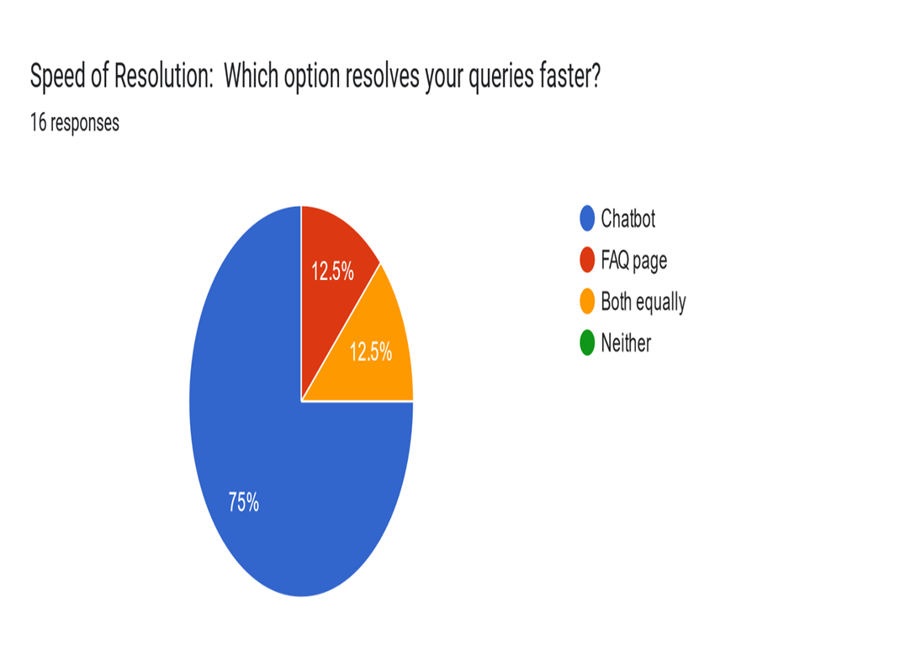
SURVEY RESULTS

Slide 7
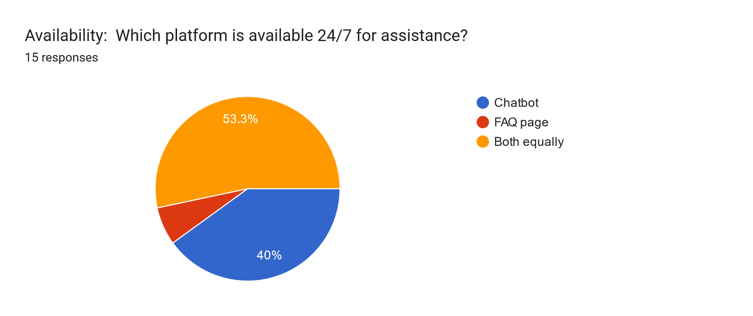
SURVEY RESULTS

Slide 8
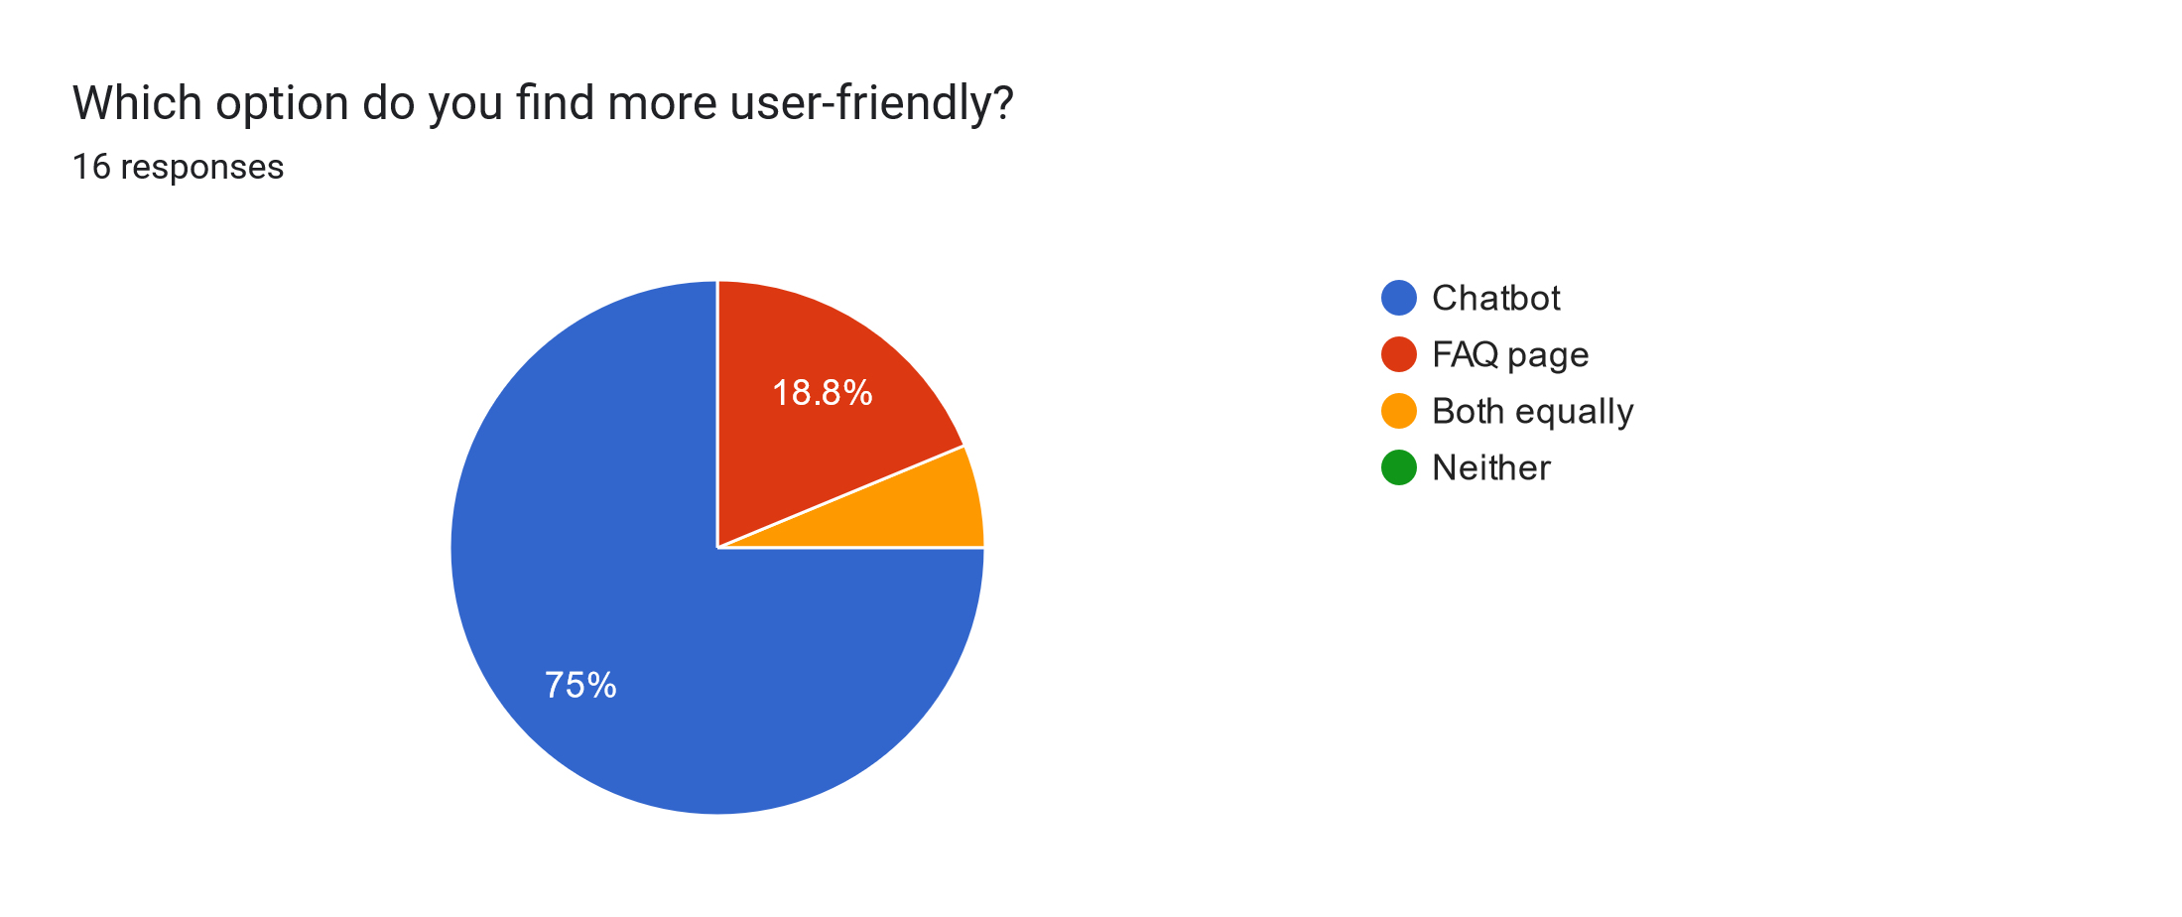
SURVEY RESULTS

Slide 9
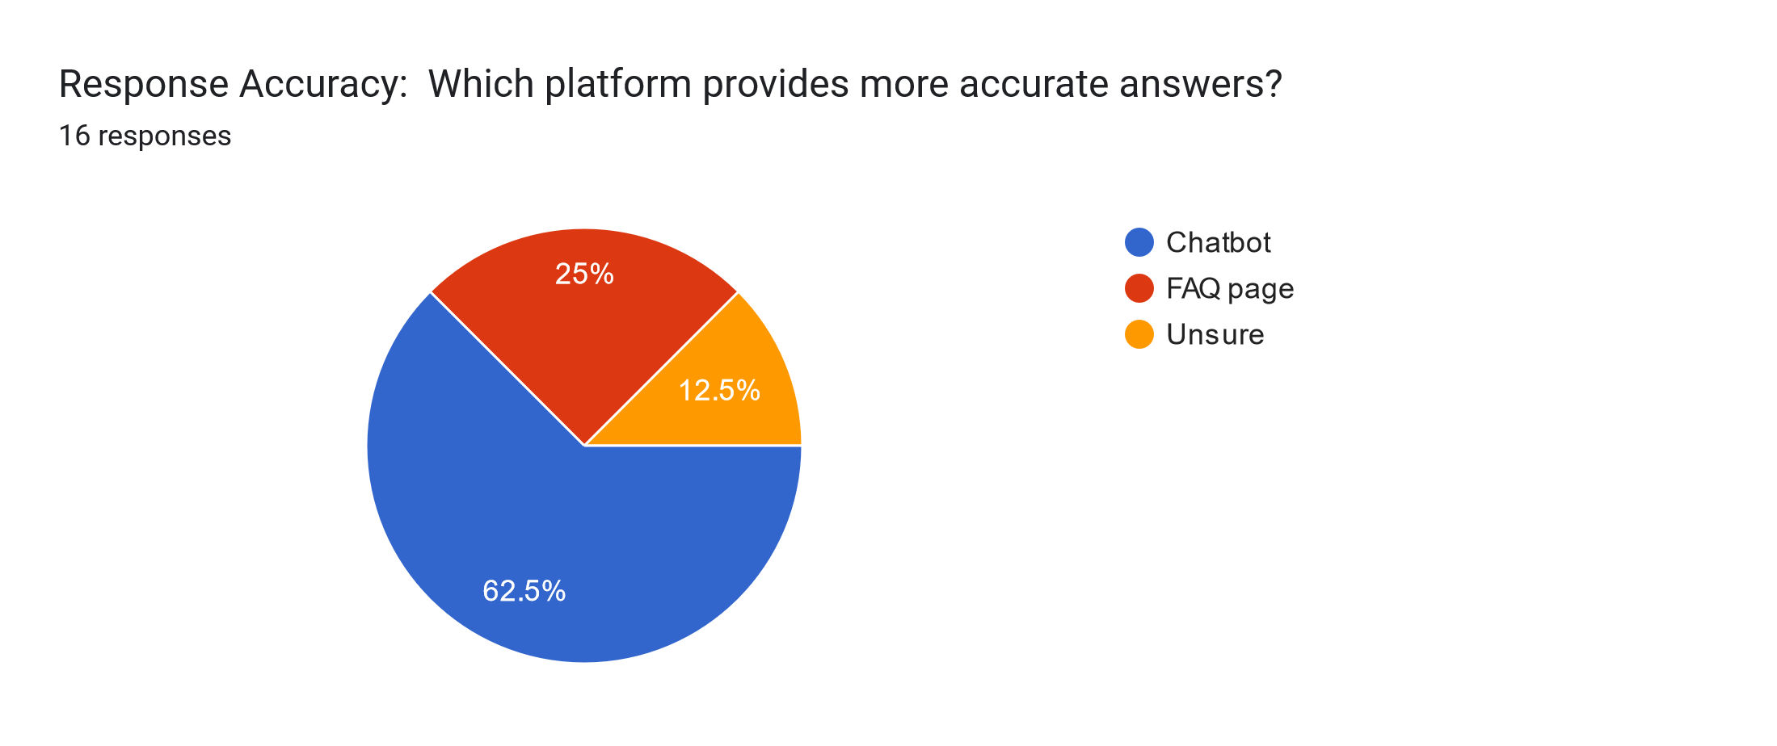
SURVEY RESULTS

Slide 10
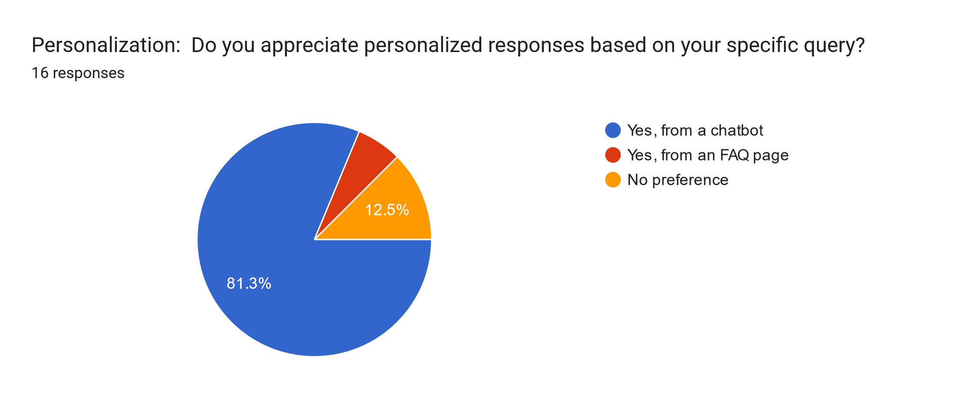
SURVEY RESULTS

Slide 11
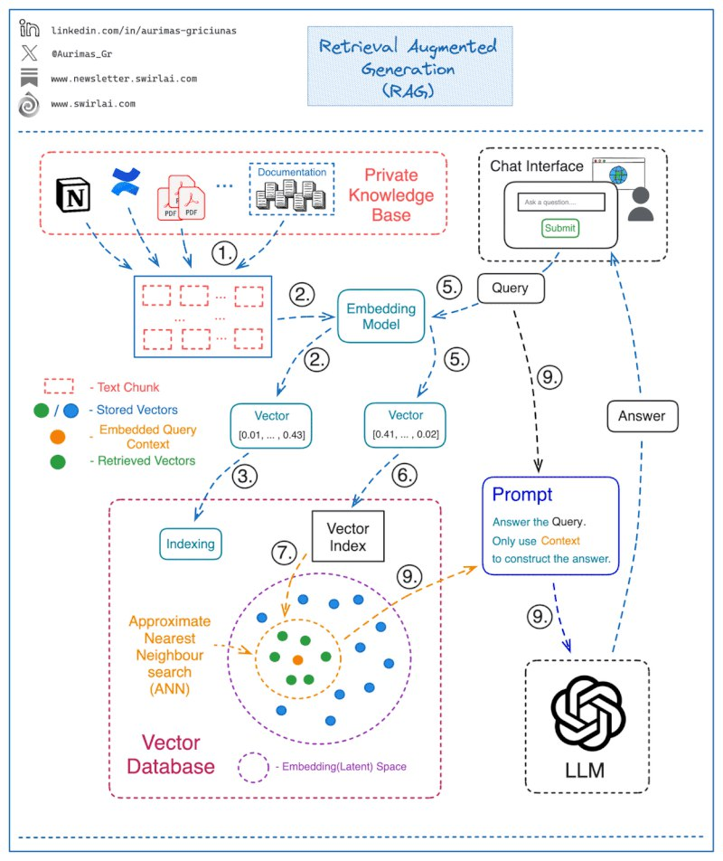
App design

Slide 12
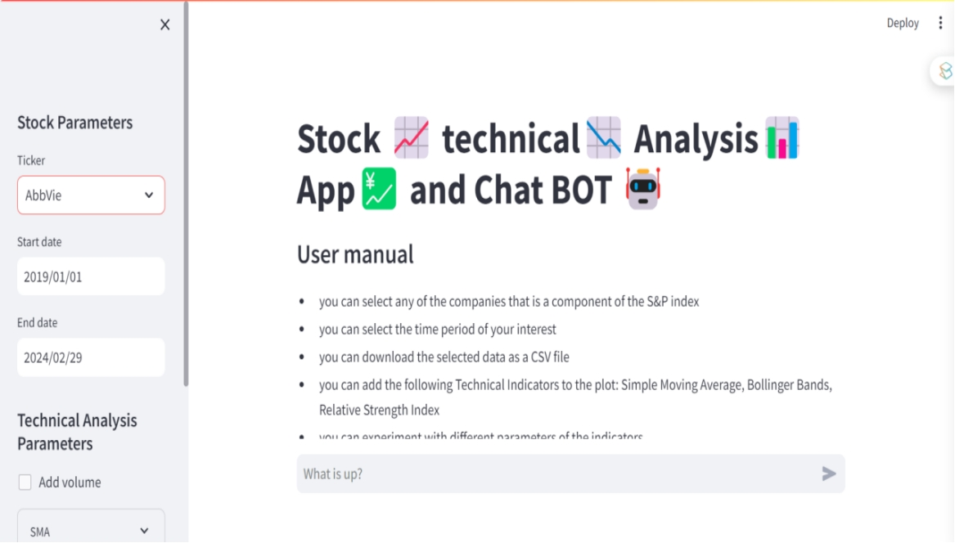
App result

Slide 13
App result

Slide 14
References
Yang, S. (2023, April 8). 4 Ways of Question Answering in LangChain. Towards Data Science
.https://towardsdatascience.com/4-ways-of-question-answering-in-langchain-188c6707cc5a
Brandtzæg, P. B., & Følstad, A. (2017). Why People Use Chatbots. Lecture Notes in Computer Science. https://doi.org/10.1007/978-3-319- 70284-1_30
Bittner, E., OesteReiss, S., & Leimeister, J. (2019). Where is the Bot in our Team? Toward a Taxonomy of Design Option Combinations for Conversational Agents in Collaborative Work. HICSS. https://doi.org/10.24251/HICSS.201 9.035
Hwang, S., Kim, B., & Lee, K. (2019). A Data Driven Design Framework for Customer Service Chatbot. Lecture Notes in Computer Science. https://doi.org/10.1007/978-3-030- 23570-3_1

